Slide 1
UNIT 4 OPERATORS AND EXPRESSION LH – 4HRS
PRESENTED BY:
ER. SHARAT MAHARJAN
C PROGRAMMING

Slide 2
CONTENTS (LH – 4HRS)
4.1 Arithmetic operator,
4.2 Relational operator,
4.3 Logical operator,
4.4 Assignment operator,
4.5 Operator increment/decrement,
4.6 Conditional operator,
4.7 Bitwise operator,
4.8 Comma operator,
4.9 Sizeof Operator,
4.10 Operator Precedence and Associativity,
4.11 Expressions and its Evaluation,
4.12 Type Casting in Expression, Program Statement

Slide 3
Operator:
An operator is a symbol that tells the compiler to perform specific mathematical or logical functions.
For example, consider the below statement:
c=a+b;
Here, ‘+’ is the operator known as the addition operator and ‘a’ and ‘b’ are operands. The addition operator tells the compiler to add both of the operands ‘a’ and ‘b’.
Operator Classification:
According to Number of Operands
Unary Operators: The operators which require only one operand to operate are called unary operators. E.g. ++(increment operator) and --(decrement operator) are unary operators.

Slide 4
Binary Operators: The operators which require two operands to operate are called binary operators. E.g. : +(plus), -(minus), *(multiply), /(division), <(less than), >(greater than), etc are binary operators.
Ternary Operators: The operators which require three operands to operate are called ternary operators. E.g. the operator pair “?:” is a ternary operator in C.

Slide 5
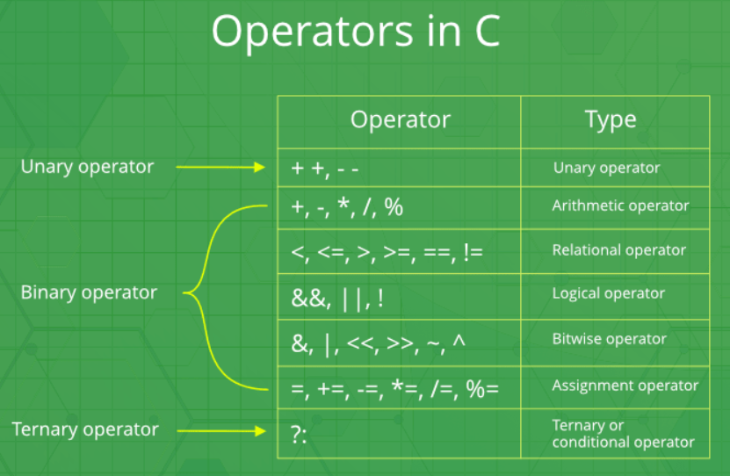
According to Utility and Action:
Arithmetic Operators
Relational Operators
Logical Operators
Assignment Operators
Increment and Decrement Operators
Conditional Operators (Ternary Operator)
Bitwise Operators
Special Operators (Comma Operator and size of Operator)

Slide 6
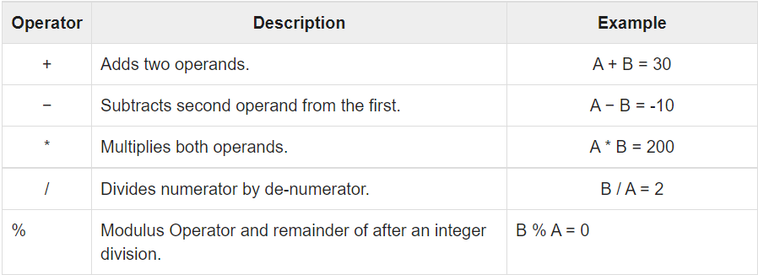
4.1 Arithmetic operator
These are the operators used to perform arithmetic/mathematical operations on operands.
The following table shows all the arithmetic operators supported by the C language. Assuming variable A holds 10 and variable B holds 20 then –

Slide 7
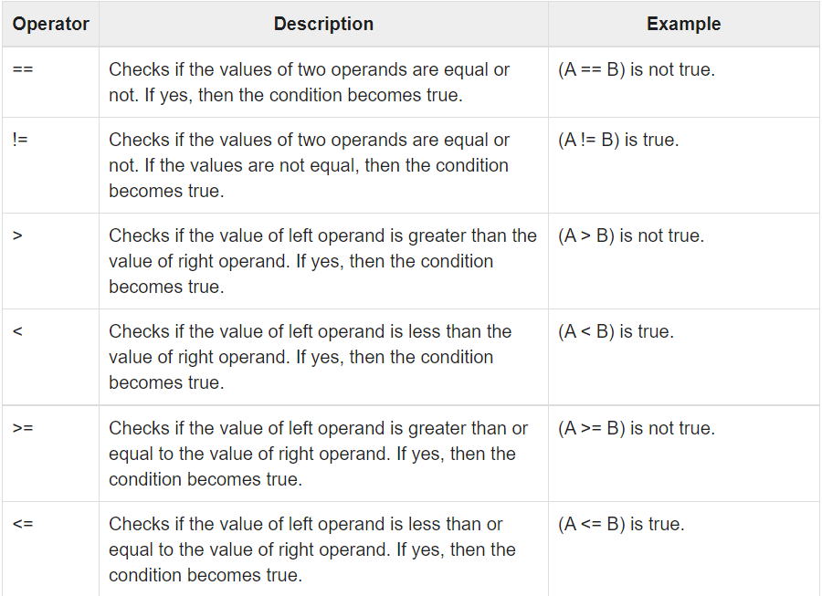
4.2 Relational operator
These are used for the comparison of the values of two operands. For example, checking if one operand is equal to the other operand or not, an operand is greater than the other operand or not, etc.
The following table shows all the relational operators supported by C. Assuming variable A holds 10 and variable B holds 20 then −

Slide 8
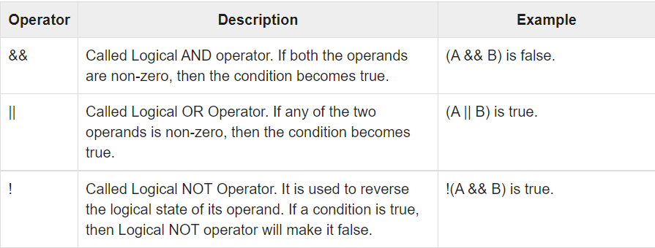
4.3 Logical operator
Logical Operators are used to combine two or more conditions or to complement the evaluation of the original condition in consideration.
For example, the logical AND represented as ‘&&’ operator in C or C++ returns true when both the conditions under consideration are satisfied. Otherwise, it returns false.
Following table shows all the logical operators supported by C language. Assume variable A holds 1 and variable B holds 0, then −

Slide 9
4.4 Assignment operator
Assignment operators are used to assign value to a variable.
The left side operand of the assignment operator is a variable and the right side operand of the assignment operator is a value.
The value on the right side must be of the same data type as the variable on the left side otherwise the compiler will raise an error.
The following table lists the assignment operators supported by the C language −

Slide 10
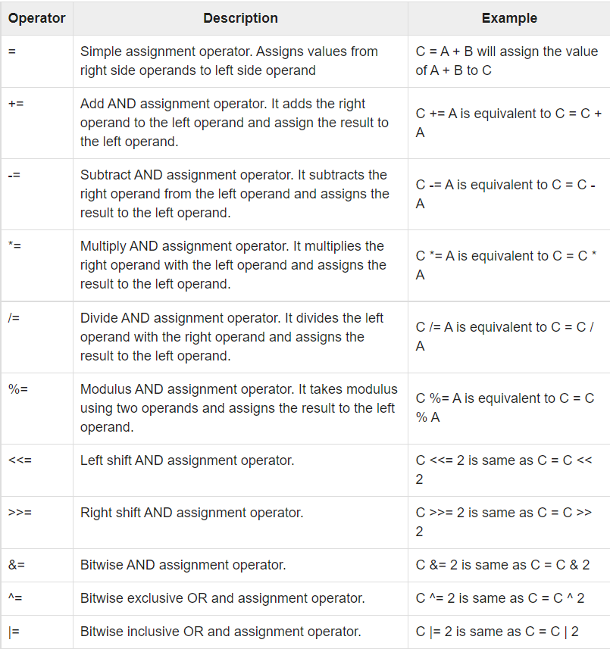

Slide 11
4.5 Operator increment/decrement
C has increment and decrement operators: ++ and --.
The operator ++ adds 1 to the operand while – subtracts 1. Both are unary operator and takes the form: prefix (++x) or postfix(x--). The x++ is same as x=x+1 (or x+=1).
While ++x and x++ means the same things when they form statement independently, they behave differently when they are used in expressions on the right-hand side of an assignment statement.
Consider an example: x=10; y=++x; in this case the values of x and y will be 11. Suppose if we write the statement as x=10; y=x++; in this case the values of x is 11 and y is 10.

Slide 12
4.6 Conditional operator
It is also known as ternary operator. A ternary operator pair “?:” is available in C to construct conditional expressions of the form: exp1?exp2:exp3; where exp1, exp2 and exp3 are expressions.
First evaluate exp1, if exp1 is true then execute exp2. If exp1 is false then execute exp3. Note that only one of the expressions (either exp2 or exp3) is executed.
Consider the following statement
int x=5,y=6,z;
z=(x>y)? x : y; in this example, z will be assigned the value of y because the value of y is larger than value of x. This operator is same as the function of if else statement.

Slide 13
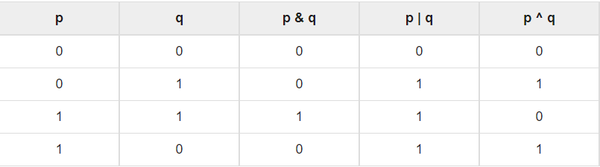
4.7 Bitwise operator
The Bitwise operators are used to perform bit-level operations on the operands. The operators are first converted to bit-level and then the calculation is performed on the operands.
Bitwise operator works on bits and perform bit-by-bit operation. The truth tables for &, |, and ^ is as follows −

Slide 14
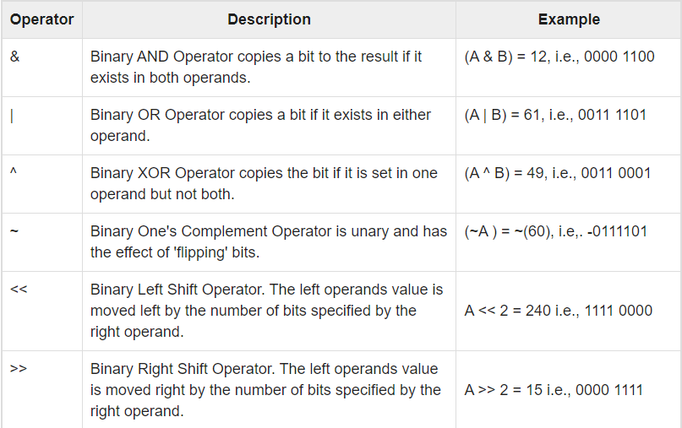
A = 0011 1100
B = 0000 1101
-----------------
A&B = 0000 1100
A|B = 0011 1101
A^B = 0011 0001
~A = 1100 0011
The following table lists the bitwise operators supported by C. Assume variable 'A' holds 60 and variable 'B' holds 13, then −

Slide 15
4.8 Comma operator
It is also special type of operator used in C.
It is used to separate the identifiers/expressions, variable declaration etc.
For example:
int p,q,r;
int a=2,b=5;

Slide 16
4.9 Sizeof Operator
This is unary operator which finds out number of bytes that any object occupies in computer’s memory. It looks like a function but really an operator.
The syntax of sizeof operator is
sizeof(object)
For example:
int x;
then sizeof(x) will return 4.

Slide 17
4.10 Operator Precedence and Associativity
Operator precedence determines the grouping of terms in an expression and decides how an expression is evaluated. Certain operators have higher precedence than others; for example, the multiplication operator has a higher precedence than the addition operator.
For example, x = 7 + 3 * 2; here, x is assigned 13, not 20 because operator * has a higher precedence than +, so it first gets multiplied with 3*2 and then adds into 7.
Here, operators with the highest precedence appear at the top of the table, those with the lowest appear at the bottom. Within an expression, higher precedence operators will be evaluated first.

Slide 18
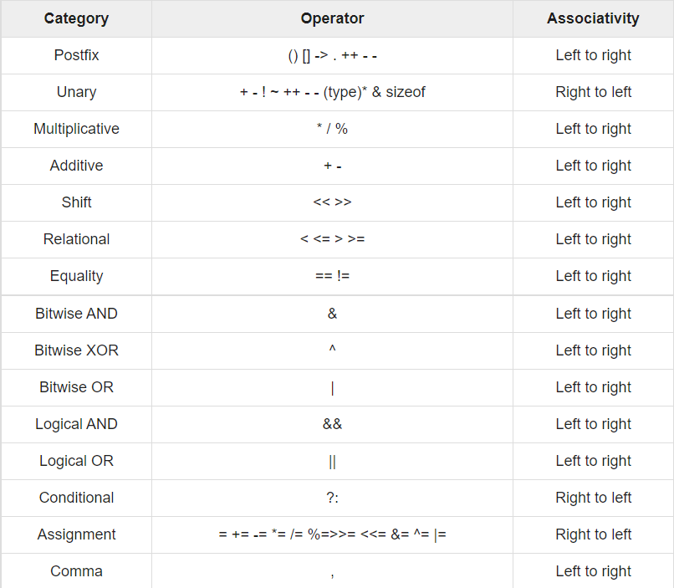

Slide 19
4.11 Expressions and its Evaluation
Let us consider of evaluating expression z=(x/(y-z)+p)*q.
First evaluate (y-z) then this difference will divide to x and result is added to p. Finally the total result is multiplied by q.
Example: Evaluate the following expression
i=2*3/4+4/4+8-2+5/8

Slide 20
Solution:
Stepwise evaluation of above expression
i=2*3/4+4/4+8-2+5/8
i=6/4+4/4+8-2+5/8 operator * is evaluated
i=1+4/4+8-2+5/8 operator / is evaluated
i=1+1+8-2+5/8 operator / is evaluated
i=1+1+8-2+0 operator / is evaluated
i=2+8-2+0 operator + is evaluated
i=10-2+0 operator + is evaluated
i=8+0 operator - is evaluated
i=8 operator + is evaluated

Slide 21
4.12 Type Casting in Expression, Program Statement
Typecasting is converting one data type into another one. It is also called as data conversion or type conversion in C language. It is one of the important concepts introduced in ‘C’ programming.
‘C’ programming provides two types of type casting operations:
Implicit type casting (Automatic type conversion)
Explicit type casting (Type cast)

Slide 22
Implicit type conversion
In this, the lower ‘type’ is automatically converted to the ‘higher’ type before the operation proceeds and the result is of the ‘higher’ type.
This type of conversion is automatically done by compiler at the time of compilation.
The following rule will be used to convert data types automatically.
char->short->int->long->float->double->long double
Example:
#include <stdio.h>
int main() {
int num = 13;
char c = 'k'; /* ASCII value is 107 */ OUTPUT: sum = 120.000000
float sum;
sum = num + c;
printf("sum = %f\n", sum );}

Slide 23
Explicit type conversion
Sometimes, a programmer needs to convert a value from one type to another in a situation where the compiler will not do it automatically. It is done by programmer as per need to convert one type to another is called explicit type conversion.
Syntax: (data type) expression;
For example: p is of int type and it is needed to be converted into float type then
int p;
(float)p; //p will be converted into float type
The value of p will remain unchanged but type will be changed. For example if value of p=10 then after cast its value will be 10.0.

Slide 24
THANK YOU FOR YOUR ATTENTION

